Slide 1
Threat-Informed Defense
Jon Baker, Mike Cunningham, Kellyn Wagner Ramsdell, Desiree Beck
26 June 2022

Slide 2
Agenda
Identifying ATT&CK Techniques in CTI reports
Extending & Customizing ATT&CK
Building Attack Flows with ATT&CK
Using Security Controls to Identify Gaps

Slide 3
Setup

Slide 4
Setup
Workshop instructions can be found at
https://github.com/center-for-threat-informed-defense/first-ctid-workshop

Slide 5
Who are we?

Slide 6
The Center for Threat-Informed Defense
The Center for Threat-Informed Defense is a privately funded research and development organization focused on advancing the state of the art and the state of the practice in threat-informed defense.
The Center serves a focal point for the Threat-Informed Defense Community, driving applied research and advanced development to improve cyber defense at scale for the global community.
The Center brings together sophisticated security teams from around the world to identify and solve the most-pressing problems facing cyber defenders.

Slide 7
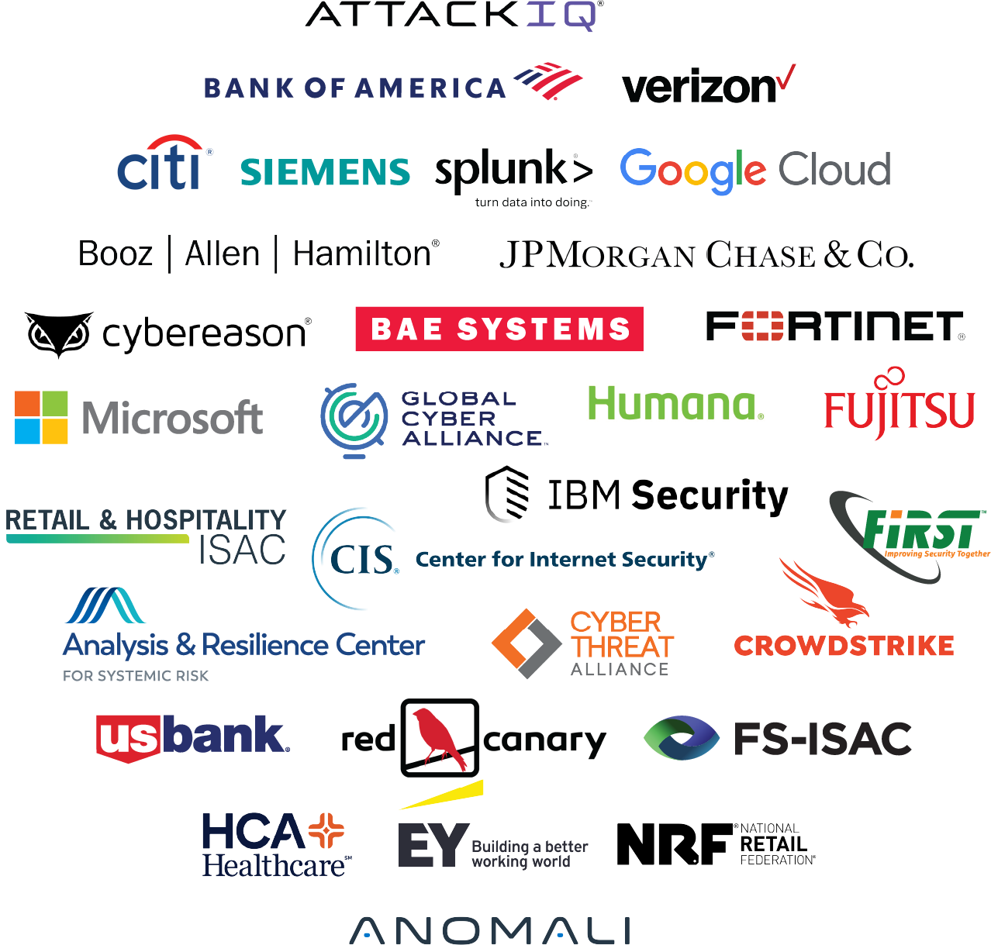

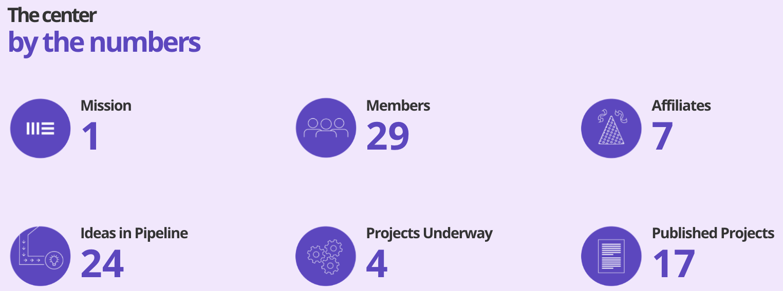
The Center for Threat-Informed Defense conducts collaborative R&D projects that improve cyber defense at scale
Membership is:
Highly-sophisticated
Global & cross-sector
Non-governmental
Committed to collaborative R&D in the public interest
+
A privately funded research and development organization working in the public interest.
© 2022 MITRE Engenuity. Approved for public release.
Notes:
Key points:
We combine the best security teams from around the world with the expertise and objective insights of MITRE
We’re focused on advancing the state of the art and the state of the practice in threat-Informed Defense: the systematic application of deep understanding of adversary tradecraft and technology to protect against, detect and mitigate cyber attacks.

Slide 8

Problem Areas:
Cyber Threat Intelligence:
Increase operational effectiveness of threat-intel products and advance the global understanding of adversary behaviors.
Test & Evaluation:
Bring the adversary perspective to test and evaluation to understand defensive posture.
Defensive Measures:
Systematically advance our ability to detect and prevent adversary behaviors.
Center project outputs are made freely-available.

Slide 9
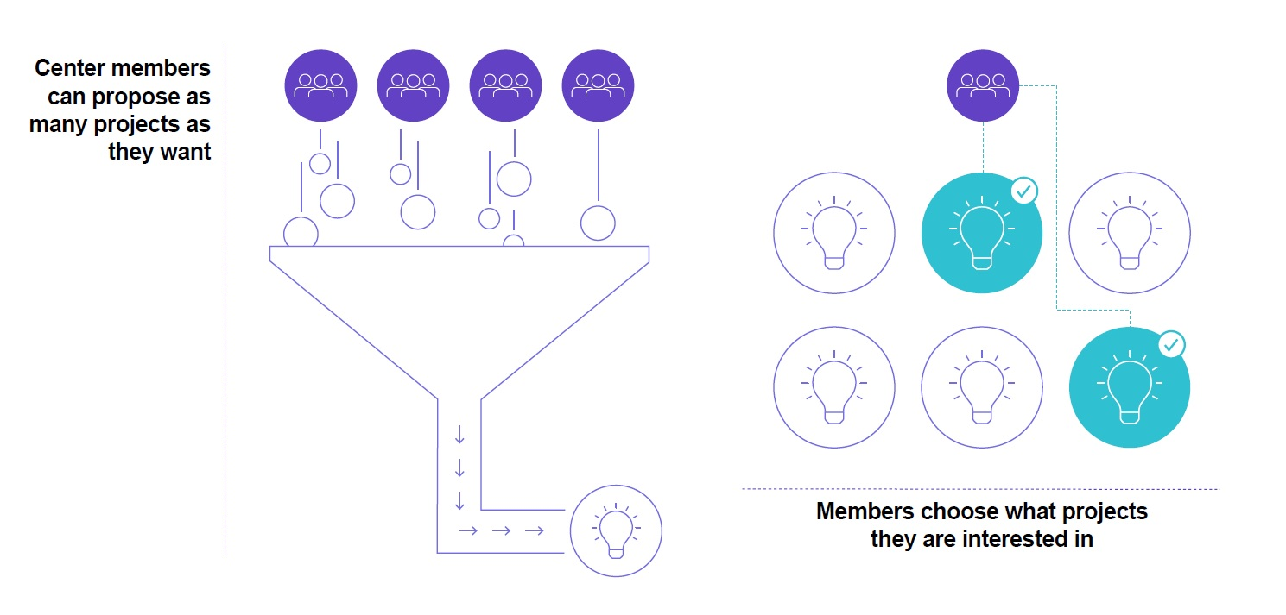
Our repeatable, scalable, agile research projects are built on member-powered collaboration
© 2022 MITRE Engenuity. Approved for public release.
Notes:
Key points:
Our membership-based model allows us to tackle multiple, cutting-edge projects.
Our sophisticated, global, multi-sector center participants submit ideas to what we call our idea market.
The Center selects projects based on the latest insights, important problems to tackle, priorities of the center and funding availability.
Member-funded R&D projects are assigned to dedicated expert MITRE staff
The cost of the project is equally divided across all of the sponsoring members – the “R&D Investment Multiplier” making Center R&D extremely cost-effective
Those experts work on the projects and then output new, R&D projects that are freely available for all.
We don’t focus only on one project at a time. We have multiple projects in multiple stages at the same time.

Slide 10
Setting the stage

Slide 11

Workshop Scenario
Conti will serve as our theme
Mapping a Conti report
Adding Conti spinoff to ATT&CK
Model in Attack Flow
Identify defensive gaps

Slide 12
Conti Threat Group
Sophisticated ransomware operators
Operates in an affiliate model with partnerships across multiple other threats groups
Uses a variety of techniques common across threat groups
While their operations have recently declined, preparing for a group like Conti will prepare an organization for many current ransomware groups.

Slide 13
HSE Compromise
On 14 May 2021, Ireland’s Health Services Executive (HSE) suffered a Conti ransomware attack
Critical Incident Process led to switching off all HSE IT systems and disconnecting HNH from the Internet
Ransom was not paid, but decryption key was provided
Recovery took over four months
Costs exceeded EUR €570 million / USD $600 million
Notes:
TODO: Add Irish Times headlines/image; get euro cost
HSE provides all of Ireland’s public health services
4K locations, 54 acute hospitals, 70K devices
HSE is largest employer in the Irish state
HNH = National Healthcare Network
Healthcare services severely disrupted

Slide 14
Identifying ATT&CK Techniques in CTI Reports
Kellyn Wagner Ramsdell

Slide 15
Mapping Approach
Start by familiarizing yourself with ATT&CK
Identify adversary behaviors
Look for verbs
Research the behaviors
Associated the behavior to a tactic

Slide 16

Additional Training
MITRE ATT&CK Defender
Recommendation: Find a mapping buddy
https://mitre-engenuity.org/mad/

Slide 17
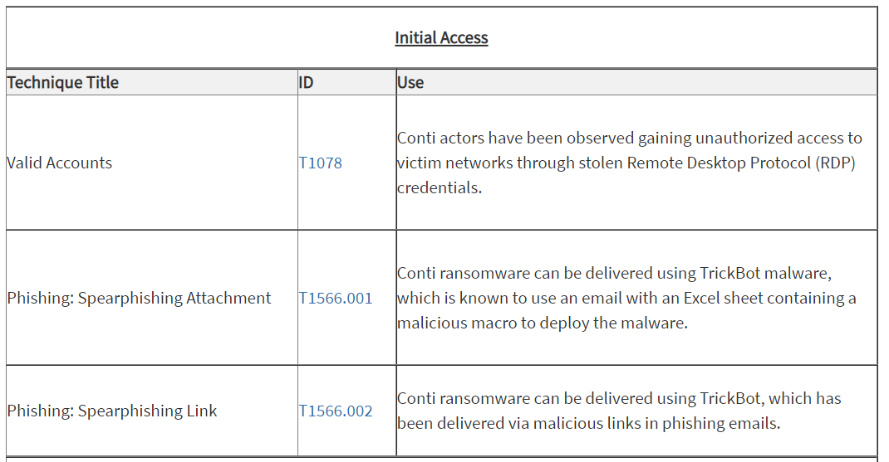
Example: US NCAS Conti Alert
Notes:
While getting familiar with mapping, may be best to start with pre-mapped reports.
Value in performing standard mapping procedure

Slide 18
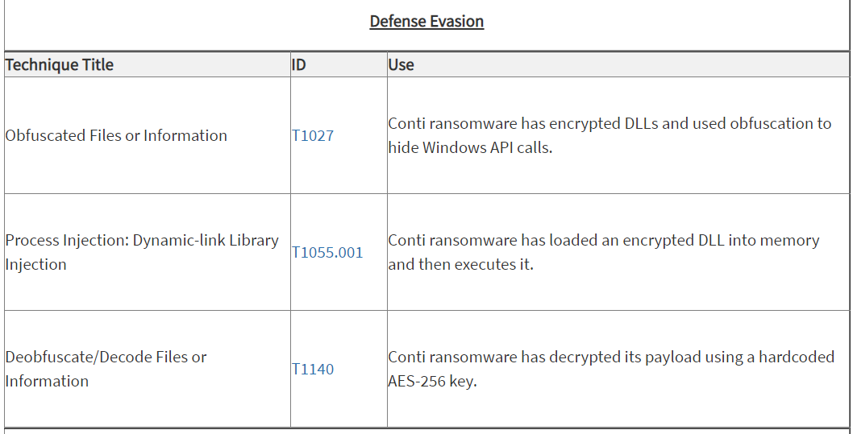
NCAS Conti Alert Continued

Slide 19
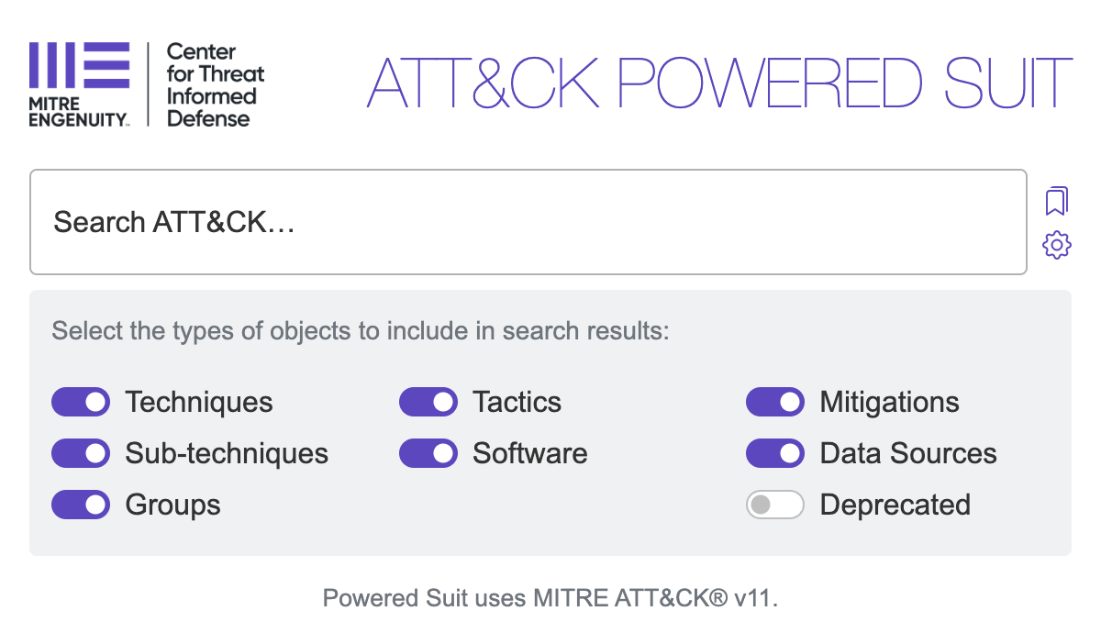

Ways to Search
ATT&CK Powered Suit Google Chrome Extension
https://attack.mitre.org/
Favored search engine

Slide 20
Hands-On Mapping Activity

Slide 21
Extending & Customizing ATT&CK
Mike Cunningham

Slide 22

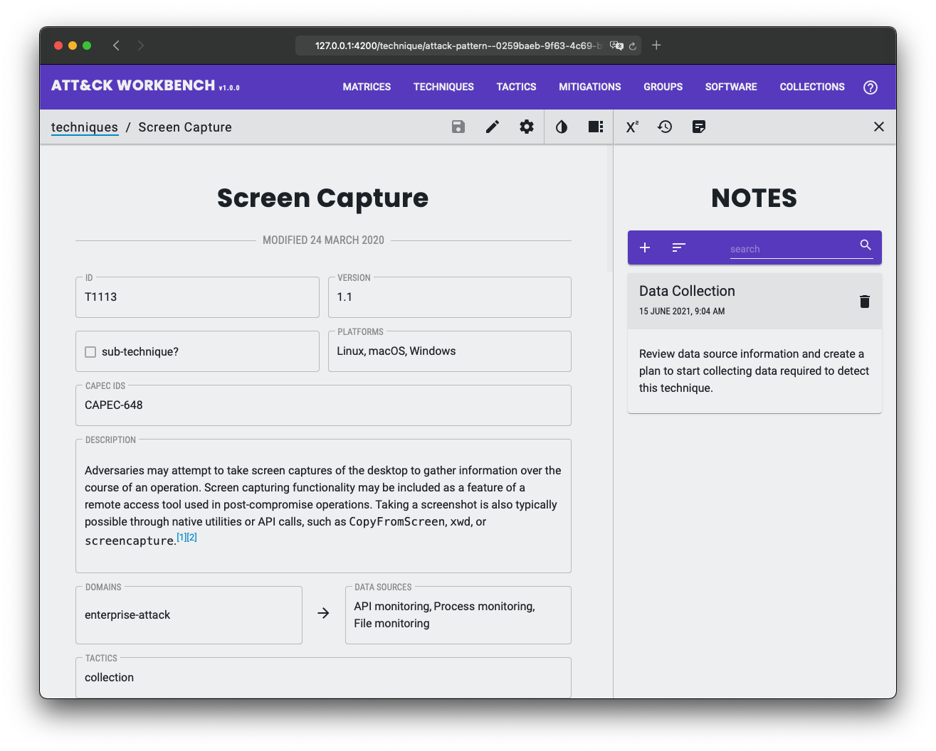



ATT&CK Workbench
Problem
Defenders struggle to integrate their organization’s local knowledge of adversaries and their TTPs with the public ATT&CK knowledge base.
Solution
Build an open-source software tool that allows organizations to manage and extend their own local version of ATT&CK and keep it in sync with MITRE’s knowledge base.
Impact
Drastically reduces the barriers for defenders to ensure that their threat intelligence is aligned with the public ATT&CK knowledge base.
Allow users to explore, create, annotate, and share extensions of MITRE ATT&CK.

Slide 23
What do we mean by “Extension?”
ATT&CK
New Objects
New Objects Are Added
+
and/or
APT3+
ATT&CK with modified objects
Credential Dumping+
Existing objects within ATT&CK are updated
MimiKatz+
FIN6+
Use Case: Expanded Group Tracking Fill in gaps in open-source reporting by creating new groups. Map new groups to new and existing techniques.
Use Case: Red Teaming Create red team techniques and track them using tooling developed for ATT&CK.
Notes:
Extending ATT&CK can mean two things
Adding new objects on top of the ATT&CK knowledge base
Extending objects already within ATT&CK with new data, e.g an updated description
So why are extensions useful?

Slide 24
Your Local Knowledge Base
ATT&CK Workbench
frontend UI
Collection Manager
ATT&CK Navigator
MITRE ATT&CK Data from GitHub
Extended ATT&CK Data
ATT&CK Website
REST API
database
Other Tools
Workbench is the cornerstone for your local infrastructure. You decide which modules you want, and which are irrelevant.
You can extend your local knowledge base with new or updated techniques, tactics, groups, and software.
Notes:
Pull down data from GitHub
Edit it in the Workbench
Use the extended data with existing ATT&CK tools

Slide 25
Sharing ATT&CK Extensions
Enterprise v9.0
The official ATT&CK knowledge base is disseminated as a collection
MITRE ATT&CK on GitHub
Enterprise v8.2
Enterprise v8.1
ISACs may share collections containing their extensions as well
ACME ISAC on GitHub
ACME Groups v1.0
ACME Software v1.0
Individual Workbench users can also publish collections
Exampleuser
on GitHub
Hello World v1.0
The Workbench provides the means to both import, create, and export collections
Exampleuser’s ATT&CK Workbench
Exporting
Importing
Notes:
Herbert Exampleuser has set up a Workbench instance and is pulling down multiple collections and publishing one of their own.
Collections are the system through which ATT&CK data and extensions can be transmitted.
Data Provider: Anyone sharing/publishing ATT&CK data or extensions.
Data Consumer: Anyone consuming that same data
Collections are STIX 2.1 JSON (more on this later)
STIX: Structured Threat Information Expression
Collection indexes (also JSON) ease dissemination by providing a listing of datasets. Basically a way for an org to say “here’s all the extensions of ATT&CK I maintain”

Slide 26
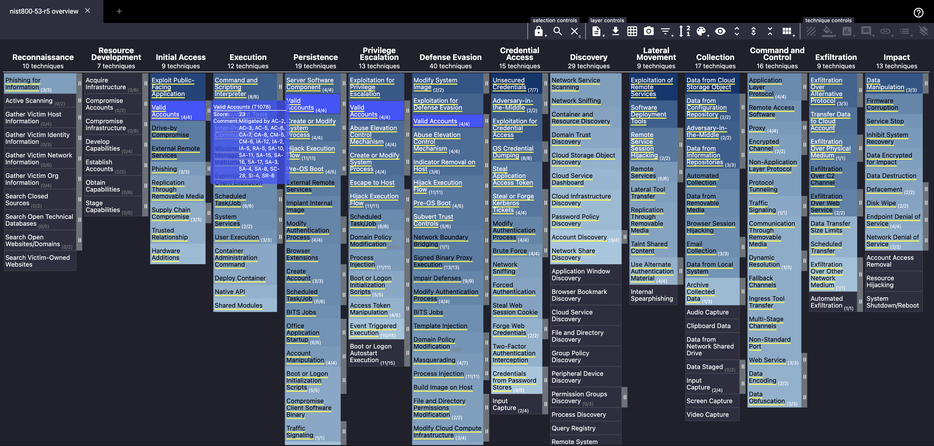
ATT&CK Navigator
Notes:
Extending ATT&CK can mean two things
Adding new objects on top of the ATT&CK knowledge base
Extending objects already within ATT&CK with new data, e.g an updated description
So why are extensions useful?

Slide 27
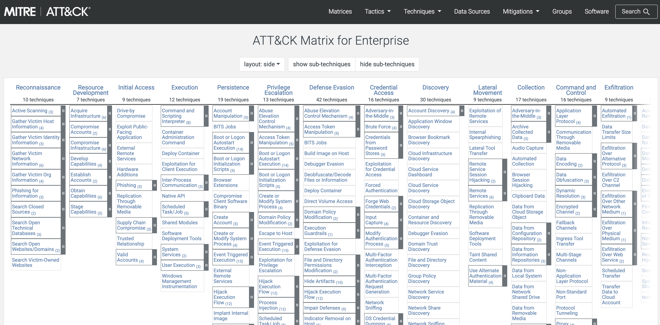
ATT&CK Website
Notes:
Extending ATT&CK can mean two things
Adding new objects on top of the ATT&CK knowledge base
Extending objects already within ATT&CK with new data, e.g an updated description
So why are extensions useful?

Slide 28
Hands-On Extension Activity

Slide 29
Building Attack Flows with ATT&CK
Dez Beck

Slide 30
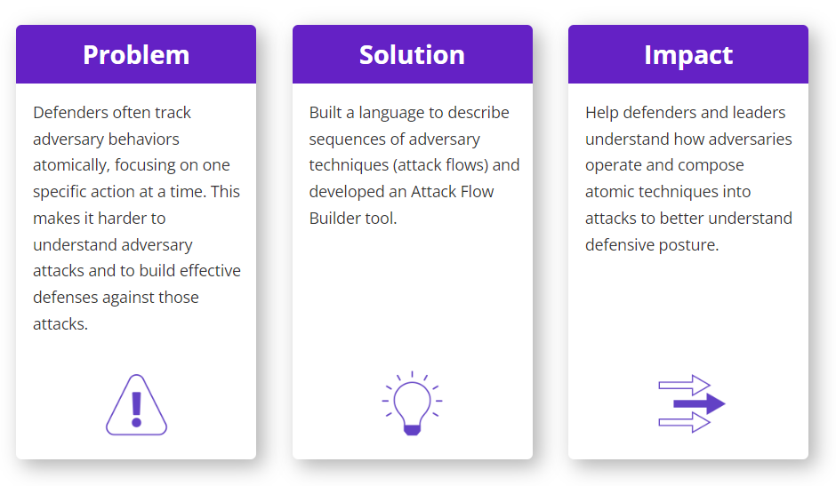
Problem-Solution-Impact

Slide 31
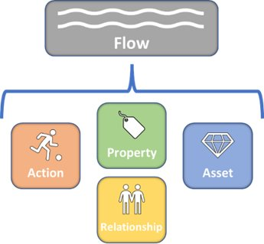
What are Attack Flows?
An attack flow is a machine-readable
representation of a sequence of actions and assets, plus knowledge properties.
https://medium.com/mitre-engenuity/attack-flow-beyond-atomic-behaviors-c646675cc793

Slide 32
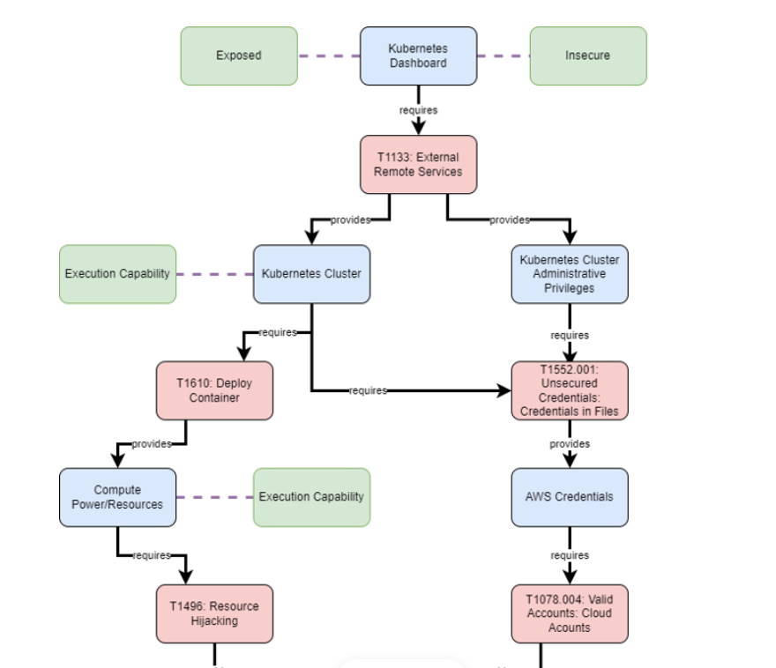
Example Attack Flow

Slide 33
Attack Flow Schema Top Level Fields
Name | Type | Description
flow | flow object | An Attack Flow Meta object.
actions | array of actions | The list of action nodes in the attack flow.
assets | array of assets | The list of asset nodes in the attack flow.
relationships | array of relationships | The list of relationship edges in the attack flow. All Actions MUST have a relationship to the flow. See Relationships table for valid pairs of source and target entities.
data_properties | array of data_properties | Data properties associate actions, assets, or flows with a piece of data.
object_properties | array of object_properties | Object properties relate actions, assets, or flows to other actions, assets, or flows.
https://github.com/center-for-threat-informed-defense/attack-flow

Slide 34
Attack Flow Schema Flow Fields
Name | Type | Description
type | enum | Indicate that this is an Attack Flow. (Enum values: “attack-flow”)
id | uri | The identifier for this Attack Flow. MUST be unique within this document.
name | string | The name of the Attack Flow.
created | date-time | Creation time of the Attack Flow (RFC-3339 format, e.g. YYYY-MM-DDThh:mm:ssZ)
author | string | The author of the Attack Flow.
description | string | The description of the Attack Flow.

Slide 35
Attack Flow Schema Action Fields
Name | Type | Description
id | uri | The identifier for this Action MUST be unique within this document.
type | enum | Indicate that this is an Action (Enum values: “action”)
name | string | The name of the action. May be at ATT&CK technique name.
description | string | A description of the action.
timestamp | date-time | The timestamp when this action was observed (RFC-3339 format, e.g., YYY-MM-DDThh:mm:ssZ)
reference | string | A reference for the action. May be a URL to an ATT&CK technique.
succeeded | number | Float from 0 (failed) to 1 (succeeded) or distribution representing the probability that action succeeded in its effects. Assumed to be 1 (100% ~ TRUE) if not included.
confidence | number | Float from 0 to 1 or distribution representing the confidence that the action succeeded. Assumed to be 1 (100% ~ ground truth) if not included.
logic_operator_language | string | The language of the logic_operator. Defaults to flow-vTBD when left blank.
logic_operator | string | The logic_operator may be any logic valid in the language defined by the logic_operator_language. If the logic_operator_language is undefined, the logic_operator may be AND or OR.

Slide 36
Attack Flow Schema Asset Fields
Name | Type | Description
id | uri | The identifier for this Asset. MUST be unique within this document.
type | enum | Indicate that this is an Asset (Enum values: “asset”)
state | string | A property that may be used as a transient string representing the state of the object during a point in time representing the current state of the system. The sum of all objects states is the state of the system. This may be as simple as “compromised”, the Confidentiality, Integrity, Availability triad, DIMFUI (Degradation, Interruption, Modification, Fabrication, Unauthorized Use, and Interception), or it may even be an arbitrary string. If not included, it is assumed that the state is “compromised” after a parent action succeeds.

Slide 37
Attack Flow Schema Relationship Fields
Name | Type | Description
source | uri | The source flow, action, or asset for this relationship.
type | uri | The type of relationship.
target | string | The target asset or action. If the target is an Action, the source MUST be an Asset. If the target is an Asset, the source MUST be an Action.

Slide 38
Attack Flow Schema Data & Object Property Fields
Data Properties Fields
Name | Type | Description
type | uri | Type (or “name”) of property.
source | uri | The source flow, action, asset, or property for this property.
target | string | Value for the specific type for the source object.
Object Properties Fields
Name | Type | Description
type | uri | Type (or “name”) of property.
source | uri | The source action or asset for this property.
target | uri | Target flow, action, asset, or property for this property.

Slide 39
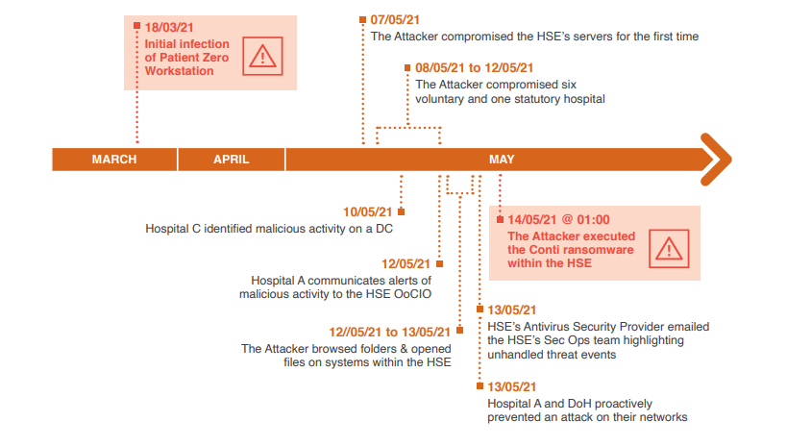
HSE Compromise
Key Events: 18 Mar to 14 May 2021
[1] PricewaterhouseCoopers Report
Notes:
Reference: [1]

Slide 40
HSE Compromise Mapping the Report
The Malware infection was the result of the user of the Patient Zero Workstation clicking and opening a malicious Microsoft Excel file that was attached to a phishing email sent to the user on 16 March 2021.
Name: (T1566.001) Phishing: Spearphishing Attachment
Description: Malicious Microsoft Excel file was attached to a phishing email
Timestamp: 2021-03-18T01:00:00
Reference: https://www.hse.ie/eng/services/publications/conti-cyber-attack-on-the-hse-full-report.pdf

Slide 41
HSE Compromise Action and Asset
ACTION
name: (T1566.001) Phishing: Spearphishing Attachment
description: Malicious Microsoft Excel file was attached to a phishing email
timestamp: 2021-03-18T01:00:00
reference: https://www.hse.ie/eng/services/publications/conti-cyber-attack-on-the-hse-full-report.pdf
OBJECT PROPERTY
target: Excel file
asset-type
state-change.compromise
OBJECT PROPERTY
target: user
asset-type
ASSET
state: compromised
DATA PROPERTY
target: user of “Patient Zero” workstation
description

Slide 42
DEMO: Attack Flow Designer

Slide 43
Attack Flow Designer GUI
Download attack_flow_designer.zip from release page*
Unzip the file
In the attack_flow_designer directory, double click on index.html
Inside the Attack Flow Designer, go to File → Open Attack Flow
Navigate to the workshop directory and open one of the *.afd files.
To create your own Attack Flow, refresh the page.
Save your Attack Flow in .afd and/or .json format
* https://github.com/center-for-threat-informed-defense/attack-flow/releases

Slide 44
Tips
There is not a single way to map!
Start with Actions
Description field should come from report, not ATT&CK
Assets
Set state to “compromised”
Data properties vs Object properties
A string description → Data property (edge: “description”)
An object/thing → Object property (edge: “asset-type”)
Relationship types
Action → Asset: “state-change.compromise”
Asset → Action: “state.compromised”

Slide 45
Mapping Exercises
There is not a single way to map!
Open and review the PWC report [1]
See "conti-pwc-report.afd“ (Timeline of the Incident)
Map DHS/CISA Alert AA21-265A [4]
Focus on text description (Technical Details)
Leverage “conti-alert-workshop-components.afd”
Compare to “conti-alert-workshop-AA21-265A.afd”
Map details from DHS/CISA Alert AA21-265A [4]
Add ATT&CK techniques from table
Map more detailed incident reports

Slide 46
Please Contribute
Become an early adopter!
Prototype capabilities
Create structured reports – contribute flows to corpus
Submit feedback as GitHub issues
Project Summary
https://ctid.mitre-engenuity.org/our-work/attack-flow
“Attack Flow – Beyond Atomic Indicators”
https://medium.com/mitre-engenuity/attack-flow-beyond-atomic-behaviors-c646675cc793
GitHub
https://github.com/center-for-threat-informed-defense/attack-flow

Slide 47
Security Controls
Mike Cunningham

Slide 48
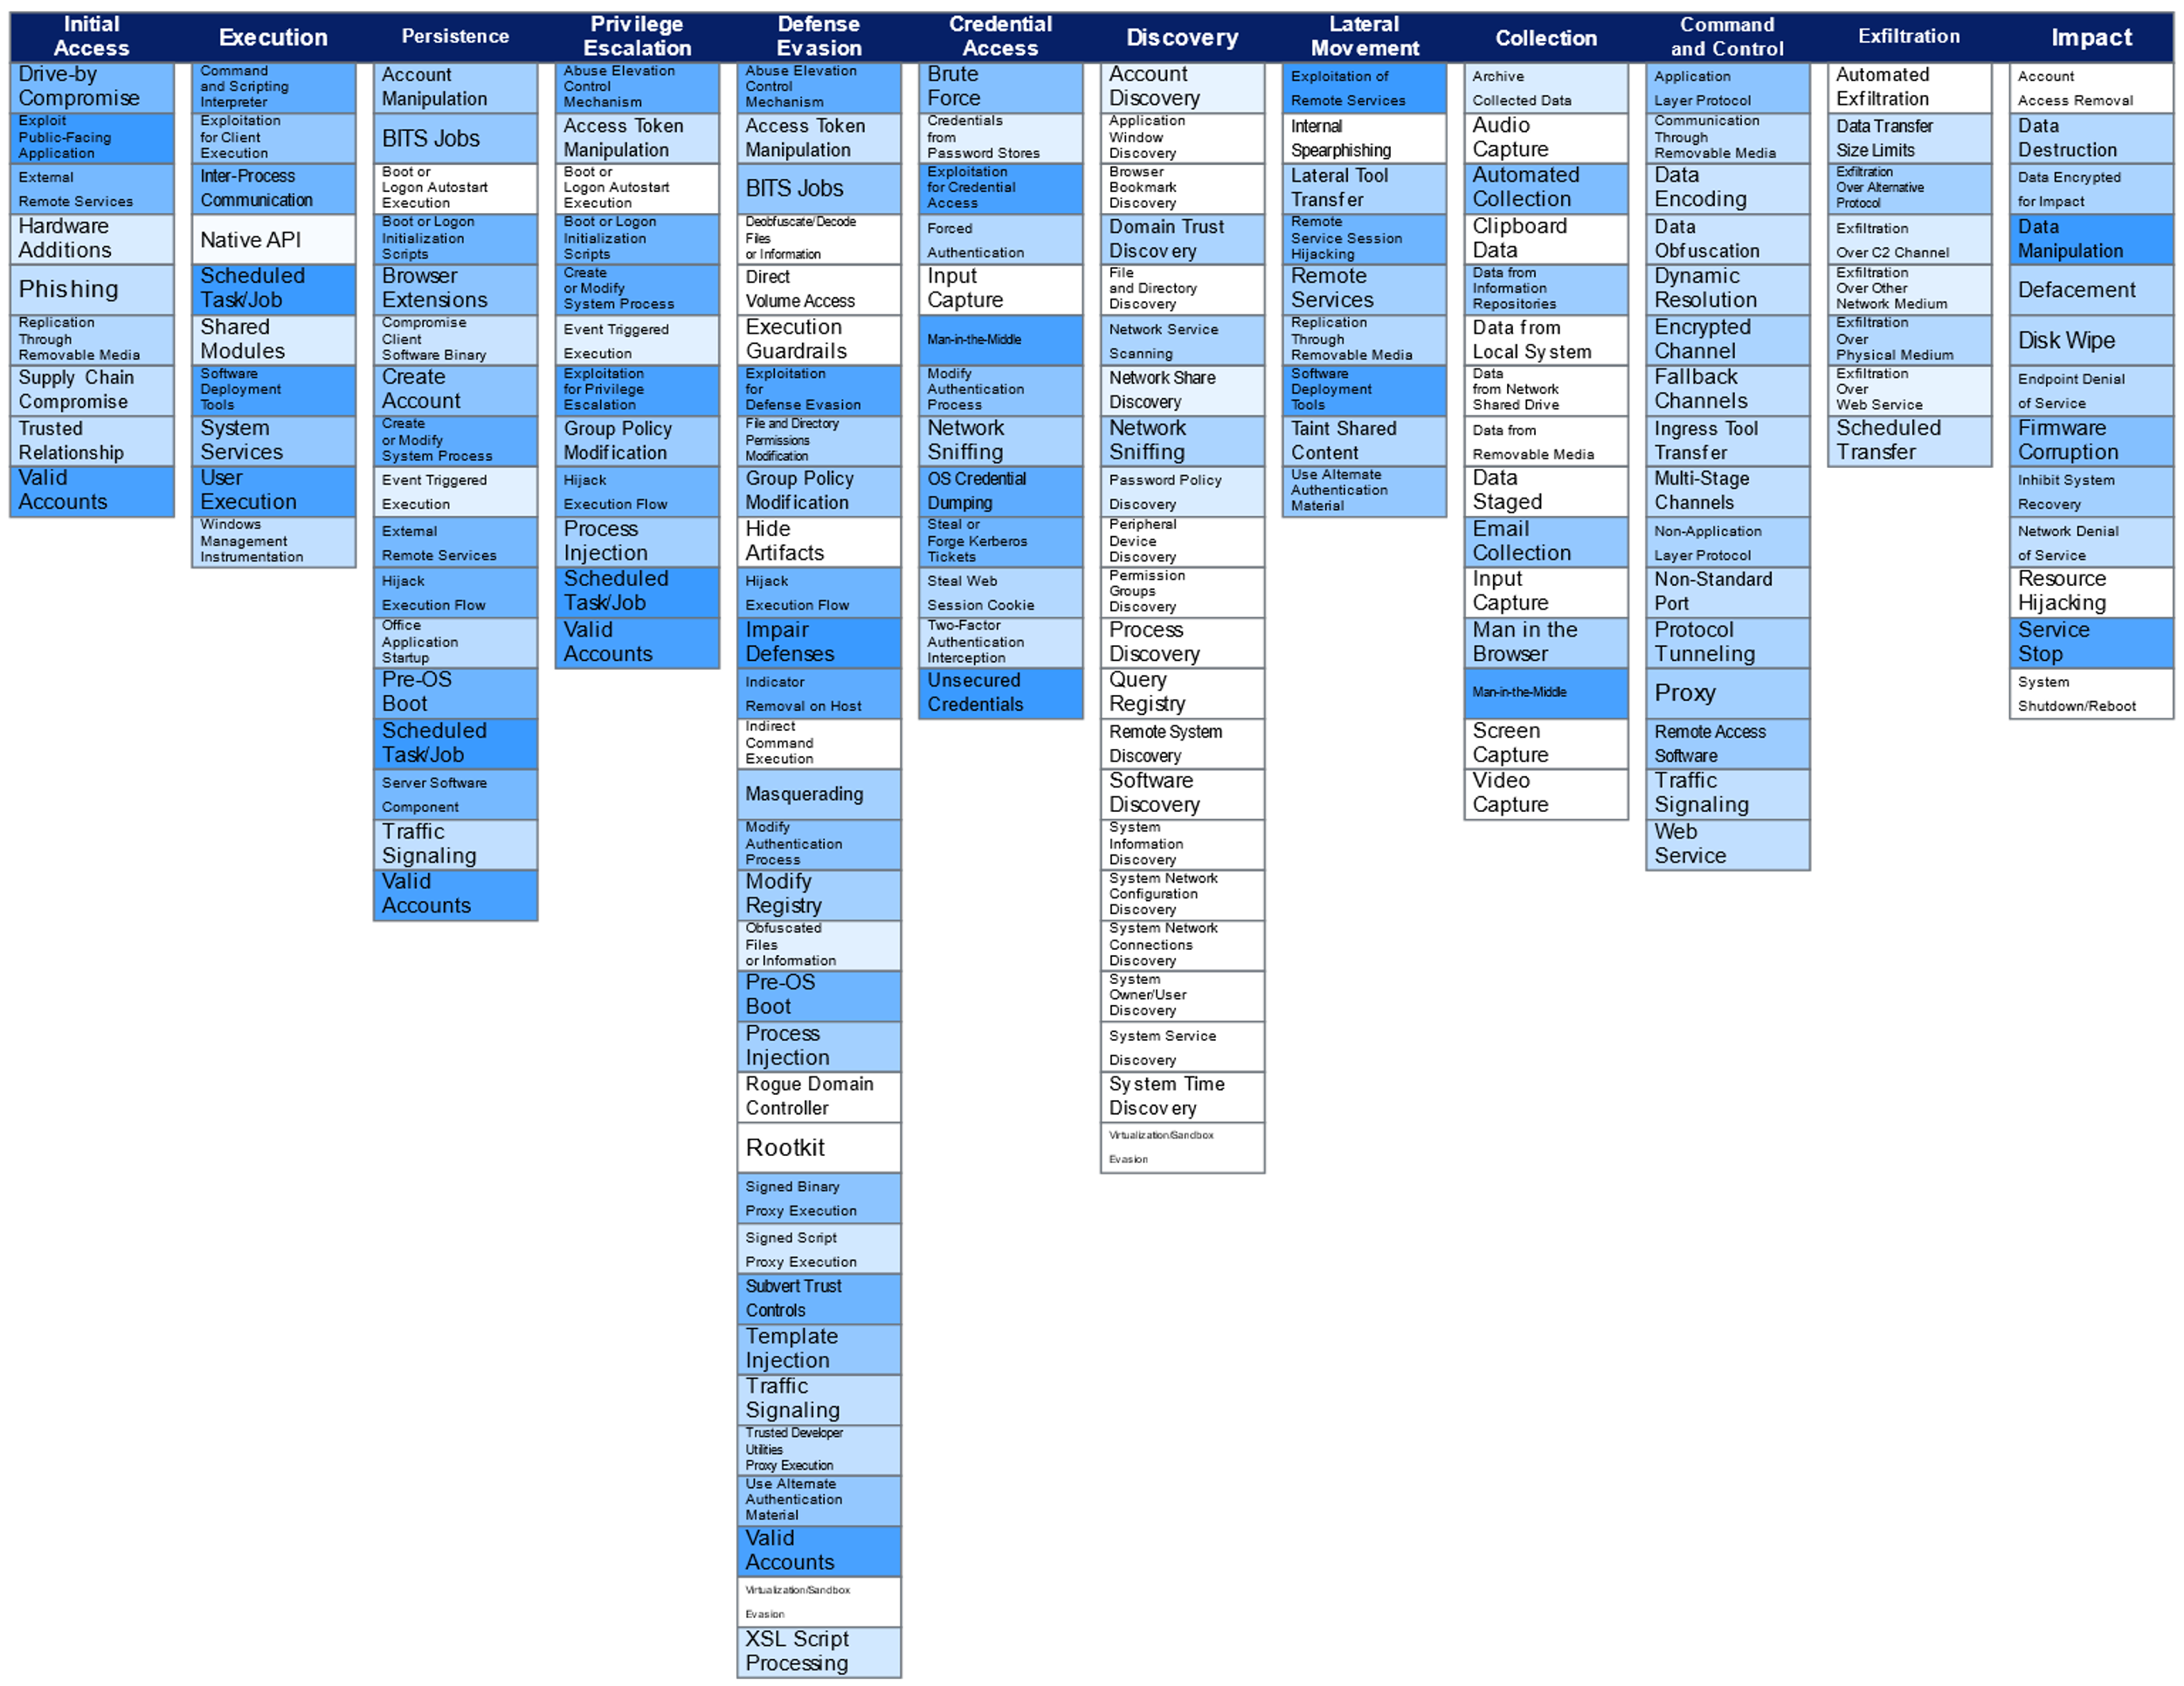

NIST 800-53 Controls to ATT&CK Mappings
Problem
Large and complex security control frameworks such as NIST 800-53 do not relate to actionable TTPs in ATT&CK.
Solution
Create a comprehensive and open, curated set of mappings between 800-53 controls and ATT&CK techniques.
Impact
Defenders can quickly focus on understanding how the controls in use in their environment relate to adversary TTPs of interest to them.

Slide 49
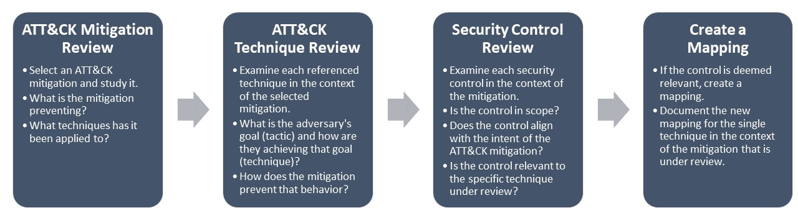
Mapping Methodology

Slide 50
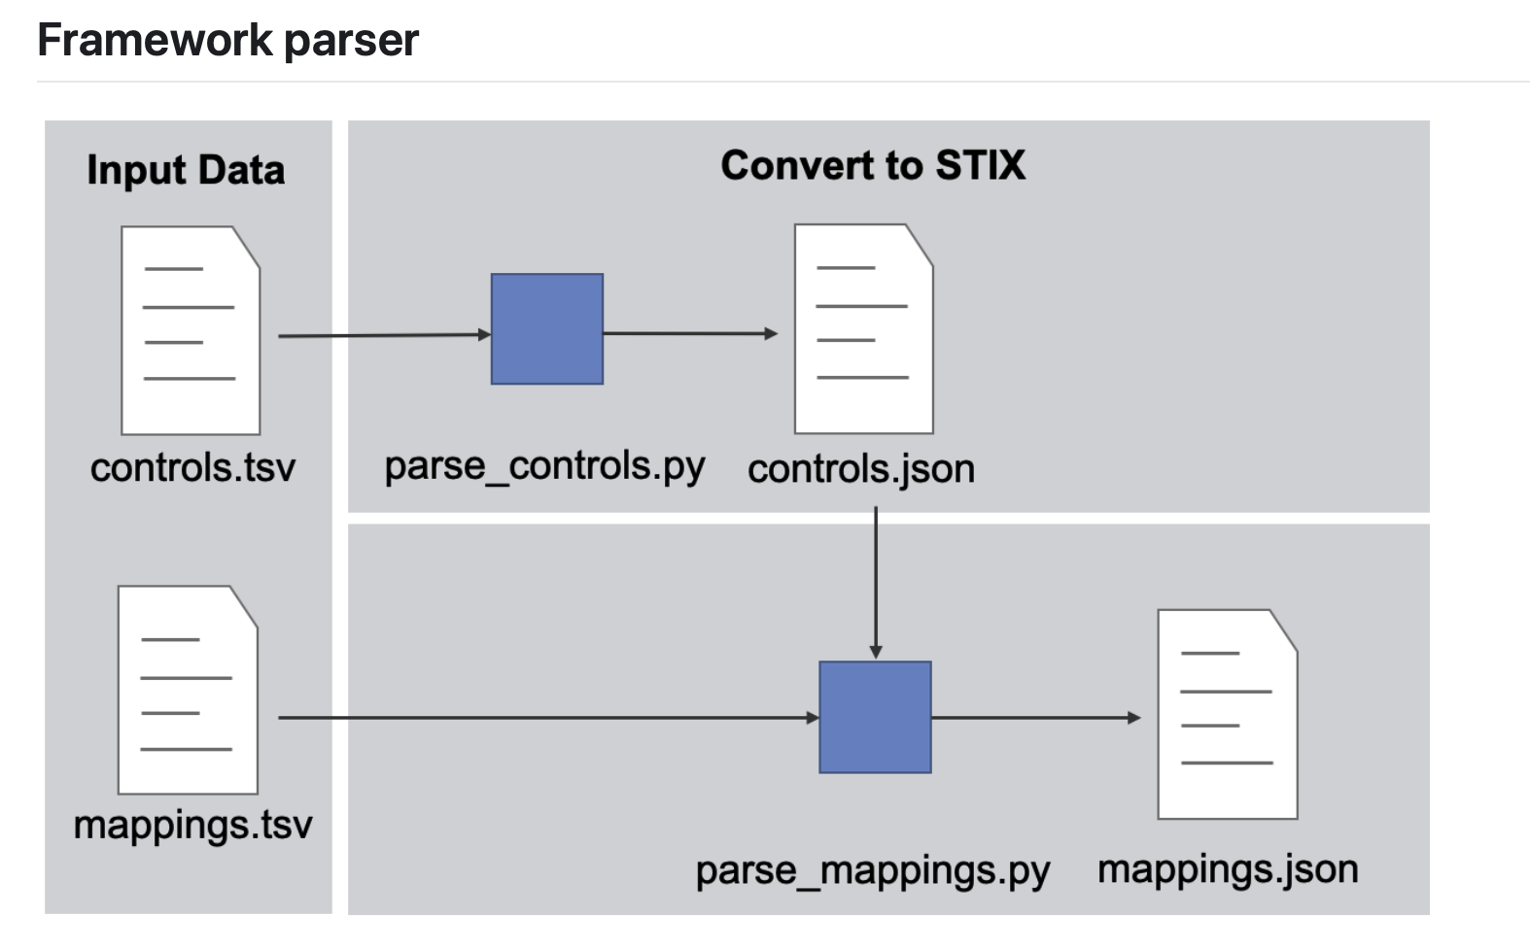
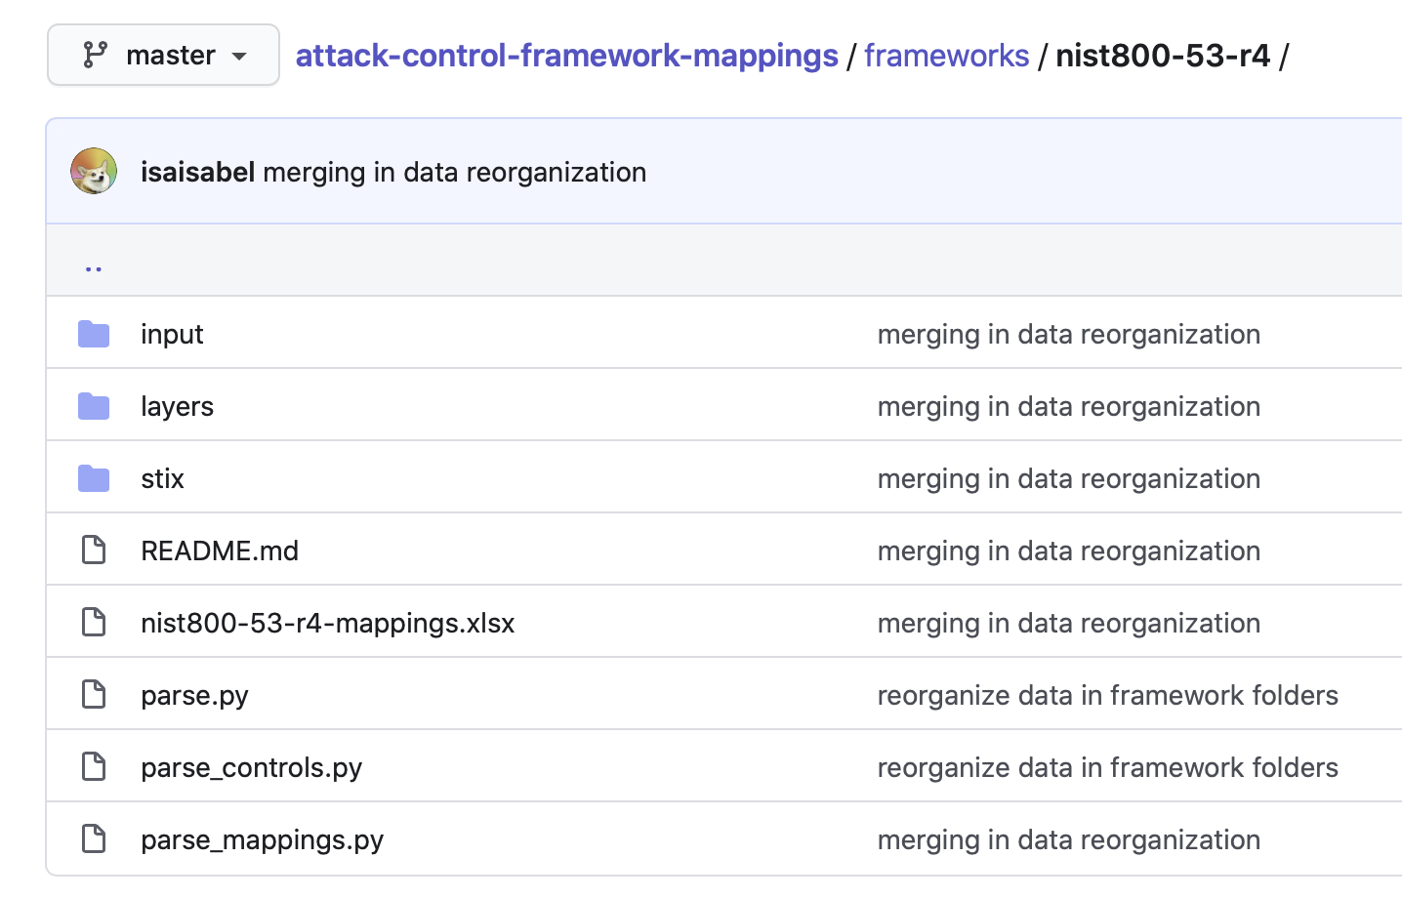
Structured Data Format

Slide 51
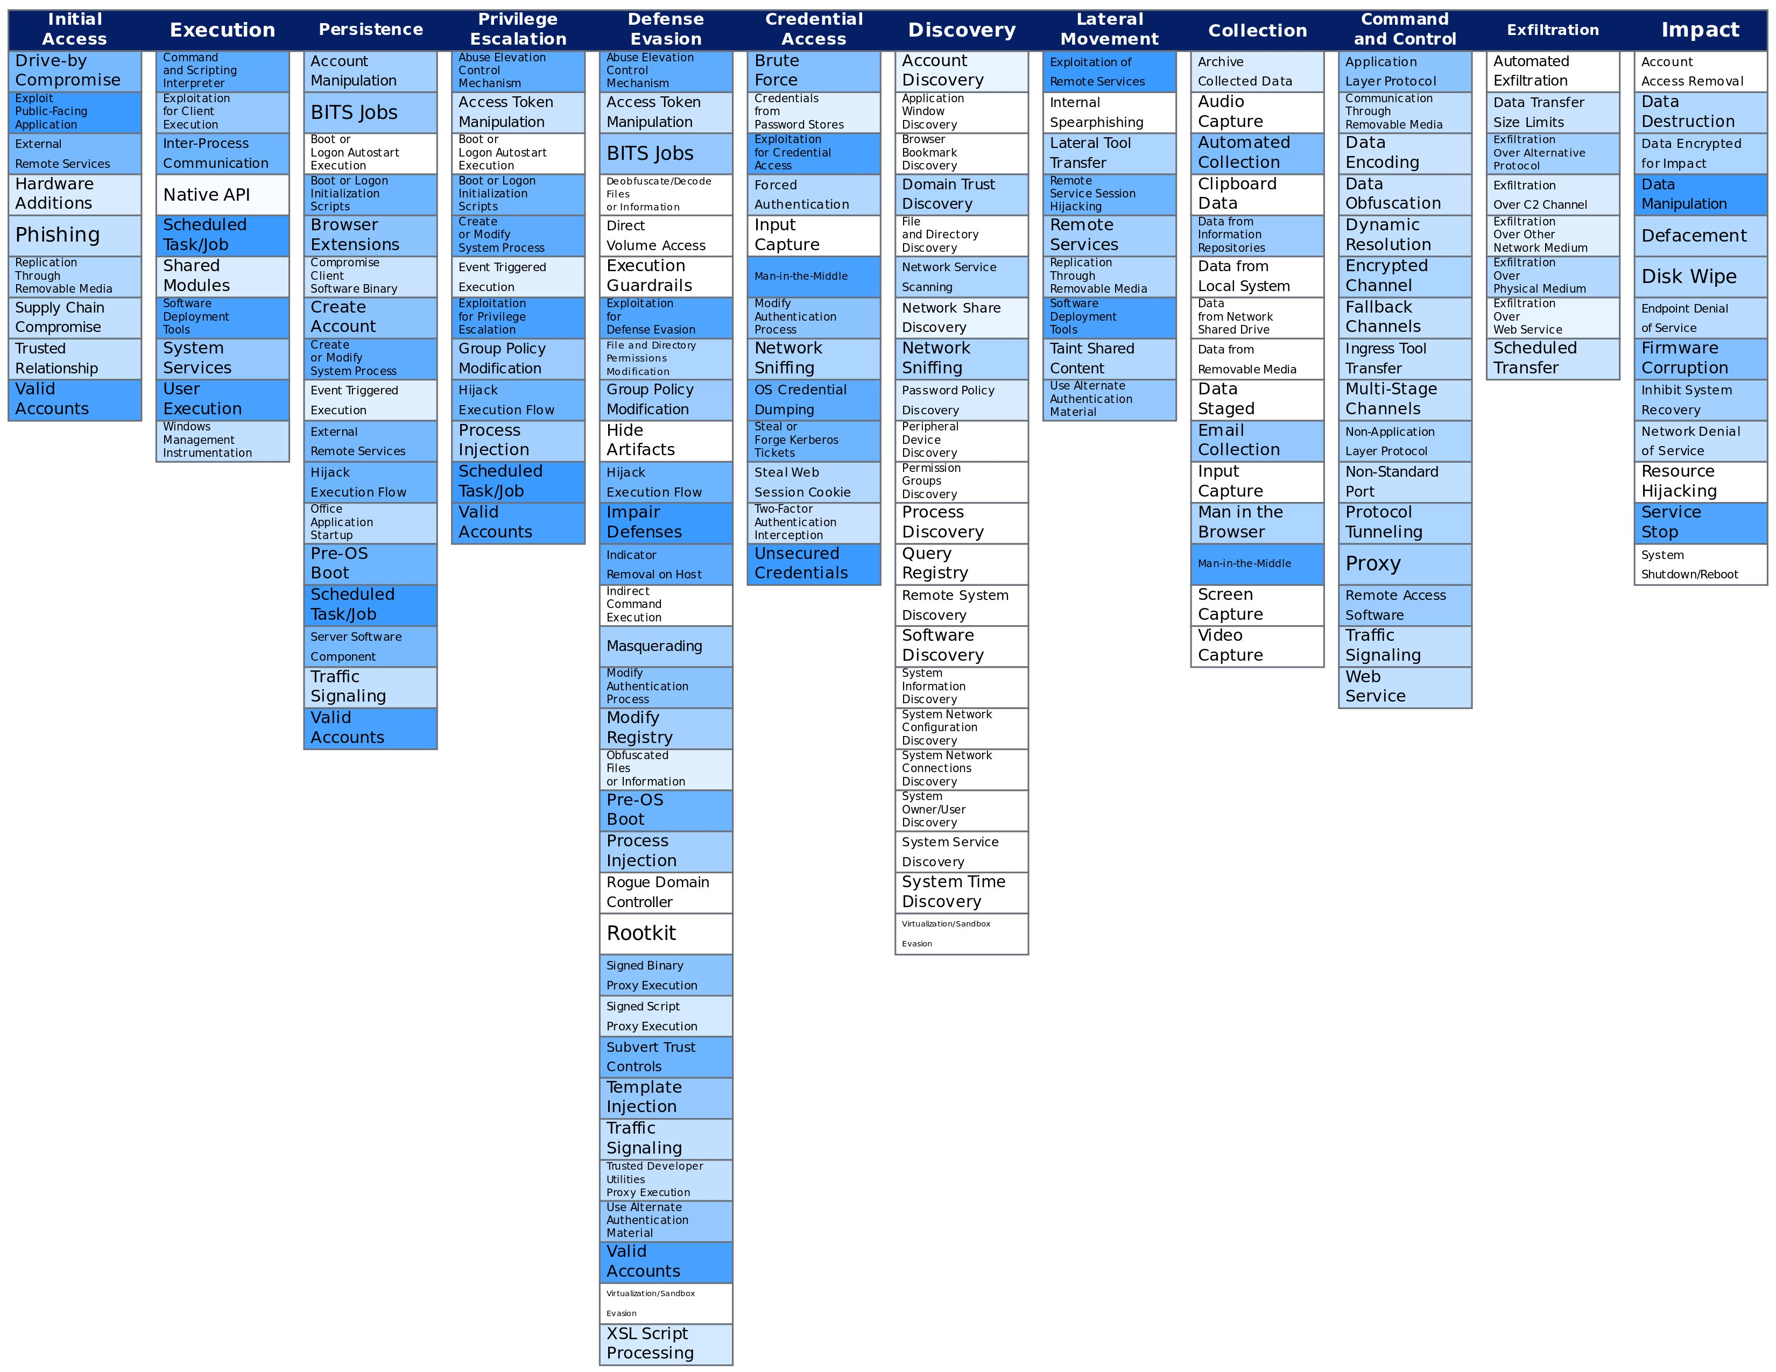
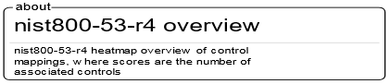
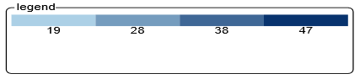
ATT&CK Navigator Visualization

Slide 52
Hands-On Applying Mappings

Slide 53
Go Raibh Maith Agat!

Slide 54
References
[1] PricewaterhouseCoopers, “Conti cyber attack on the HSE,” December 3, 2021.
[2] Brian Krebs, “Conti’s Ransomware Toll on the Healthcare Industry,” April 18, 2022
[3] Brian Krebs, “Inside Ireland’s Public Healthcare Ransomware Scare,” December 13, 2021
[4] DHS/CISA Alert (AA21-265A), “Conti Ransomware,” updated March 9, 2022
Notes:
[1] Commissioned by the HSE Board in conjunction with the CEO and Executive Management Team.
https://www.hse.ie/eng/services/publications/conti-cyber-attack-on-the-hse-full-report.pdf
[2] https://krebsonsecurity.com/2022/04/contis-ransomware-toll-on-the-healthcare-industry/
[3] https://krebsonsecurity.com/2021/12/inside-irelands-public-healthcare-ransomware-scare/
[4] https://www.cisa.gov/uscert/ncas/alerts/aa21-265a
Other refs:
https://news.sophos.com/en-us/2022/02/28/conti-and-karma-actors-attack-healthcare-provider-at-same-time-through-proxyshell-exploits/
https://news.sophos.com/en-us/2021/02/16/conti-ransomware-attack-day-by-day/
https://news.sophos.com/en-us/2021/02/16/what-to-expect-when-youve-been-hit-with-conti-ransomware/

Slide 55
Backup Slides

Slide 56
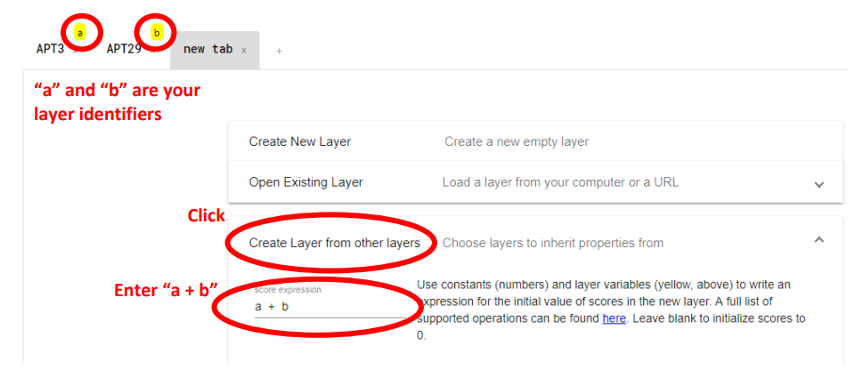
Comparing Navigator Layers
Notes:
https://attack.mitre.org/docs/Comparing_Layers_in_Navigator.pdf
To view the difference in controls versus a threat mapping, likely want to use subtraction operations.

